Slide 1
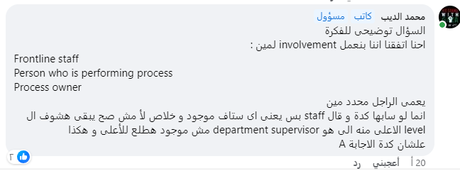
1-When JoEllen evaluates how many people in her facility's managed care plan were able to receive the flu shot. She is evaluating, under Dimensions of Performance:
A. Appropriateness.
B. Availability.
C. Effectiveness.
D. Efficacy.
2-For CQI to be successful who must be included?
A. Administrator
B. Person performing process
C. Quality management representative
D. Department supervisor

Slide 2
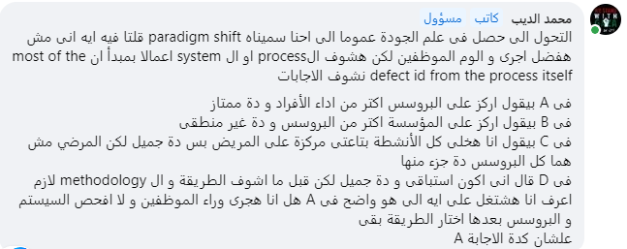
3-In the transition from quality assurance to quality management/quality improvement, which of the following emphases has resulted in the most significant benefit?
A. Focusing primarily on process rather than individual performance
B. Focusing on organization wide rather than clinical processes
C. Organizing activities around patient flow rather than department or discipline
D. Initiating more prospective rather than retrospective improvement efforts
4-The percentage of early diagnosed breast cancer after using of new imaging technique is considered:
A. Structure measure
B. Process measure
C. Outcome measure
D. Continuous measure

Slide 3
5-Under the quality improvement paradigm, which statement is incorrect?
A. The focus is on the competency of individual practitioners.
B. The focus is on the efficacy and effectiveness of processes.
C. The focus is on the patient.
D. The focus is on organization performance.
6-After defining "internal" and "external" customers, your organization is making a master-list of each type of customer before initiating a major change process. Of the following, which is the best next question to ask of staff?
A. Who do you receive services from?
B. Who in your work day do you serve?
C. Which patients receive your services?
D. How do you know a customer from a supplier?

Slide 4
7-Monitoring the specific organization and content requirements of a medical record system is a review of which focus?
a. Outcome of care
b. Process of care
c. Structure of care
d. Administration of care
8-In street Memorial hospital, a pt attending the diabetic clinic. developed foot infection, due to lack of proper personal foot hygiene,. the pt claimed that he was never informed of adequate foot care This is. considered a poor:
a. Structure indicator.
b. Outcome indicator.
c. Process indicator.
d. Benchmarking standard.

Slide 5
9-Which of the following is true regarding medication errors:-
A- associated with process failure
B- Prevented by review of evidence based practice
C- caused by gap between patients expectations and practice
D- avoid by uniform practice
10- Which of the following best describes the successful outcome of the quality improvement process?
A. Customer satisfaction
B. Enhanced communication
C. Employee empowerment
D. Improved statistical data

Slide 6
11-The most important external customer in hospital is:
A- Supplier
B- Patients
C- Employees
12-The performance indicator, “Total unscheduled inpatient admissions following ambulatory procedure (within 48 hours)” is a measure of:
a. structure.
b. process.
c. outcome.
d. process and outcome

Slide 7
13- Total quality management philosophy assumes that:
A. most problems with service delivery result from systems difficulties
B. frequent inspection is necessary to improve quality.
C. most problems with service delivery result from difficulties with individuals.
D. top management leadership in quality activities disenfranchises employees.
14-Measuring the time it takes a nurse to perform a procedure addresses which of the following aspects of care?
A. monitoring
B. process
C. outcome
D. structure

Slide 8
15-Common cause variation is:
a. An intrinsic, inliers, unpredictable, chronic variation.
b. The responsibility of the process owners .
c. Correctable by top management and the team
d. An intrinsic, outlier, unpredictable, acute variation.

Slide 9
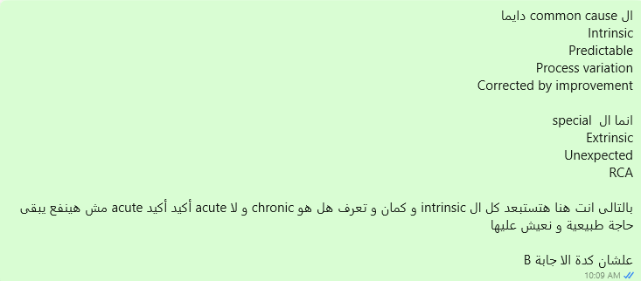
16-In special cause of variation, the source of variation is:
A-Intermittent, unpredictable, chronic , extrinsic and assignable.
B-Intermittent, unpredictable, unstable, extrinsic and assignable
C-Intermittent, inliers, unstable, extrinsic and assignable.
D-Intermittent, unpredictable, unstable, and intrinsic and assignable

Slide 10
17-One fundamental difference between monitoring product quality and service quality is based upon the fact that:
a. a service is easier to measure and verify in advance.
b. a service is not perishable.
c. a service is more heterogeneous than an object.
d. there are more service delays than product delays
18-Monitoring phlebitis associated with IV insertions by nurses in the Surgical Intensive Care Unit addresses which focus?
A. Outcome of care
B. Process of care
C. Structure of care
D. Administrative procedure

Slide 11
19-The dimension of quality/performance that is addressed by introducing a rapid response team in a hospital is:
A. continuity of care.
B. efficiency.
C. effectiveness.
D. prevention and early detection
20-In health care organization, the quality department developed an indicator to measure the commitment of the staff to Myocardial infarction guidelines .This indicator measure:
A. Process.
B. Structure.
C. Culture.
D. Outcome.

Slide 12
21-A performance measure that records the number of well-child visits within the first fifteen months of life in the reporting year is a measure of:
a. structure.
b. process.
c. outcome.
d. process and outcome
22-A process indicator is defined as one that measures:
A. an activity carried out to provide care or service.
B. significant events that require further investigation.
C. unexpected or negative variations.
D. the appropriateness of procedure or treatment

Slide 13
23-A patient diagnosed with hepatocellular carcinoma is receiving a novel chemotherapeutic agent based on promising preliminary data from clinical trials and the absence of other viable treatment options. The dimension of quality for which the medication was chosen is its:
1. efficacy.
2. effectiveness.
3. safety.
4. appropriateness.
24-“Nothing about me without me “ best describes:
A. Organizational culture
B. An all-or-none measure
C. Patient-centered care
D. The quality professional’s role

Slide 14
25-In continuous quality improvement programs, surveys are essential to determine which of the following?
A- Customer needs
B. performance standards
C. effective management
D. population demographics
26-Which of the following is example of outcome measure:
A .mortality rate.
B. average LOS.
C. medication dispensing rate.
D. lab specimen

Slide 15
27-Which of the following statements best defines a quality problem?
A. The gap between what is and what is expected by the customer.
B. The gap between what is and what is desired by the organization.
C. The gap between what is and what is the benchmark.
D. The gap between what is and what is expected by accreditation bodies.
28-Who is considered the internal costumer in an advanced nursing facility:
A. Nurse completing initial assessment
B. The patient being admitted

Slide 16
29-The following monitor provides patient outcome information:
1-the degree of compliance with nursing care recommendations.
2-the degree of compliance with prescribed antibiotics therapy.
3-an equipment malfunction rate.
4-hospital nosocomial infection rate
30-The number of productive hours worked by nursing staff with direct patient care responsibilities per patient day is a:
A- structural measure.
B- process measure.
C- outcome measure.
D- composite measure

Slide 17
31-Which of the following is an example of patient-centered care?
1. Bedside rounds
2. Using two patient identifications
3. Pre-printed discharge instructions
4. Age based dosing
32-The paradigm shift is:
A. change the reframe of thinking
B. improve the monitoring measures
C. increase the standards
D. use the recent in medicine and technologies

Slide 18
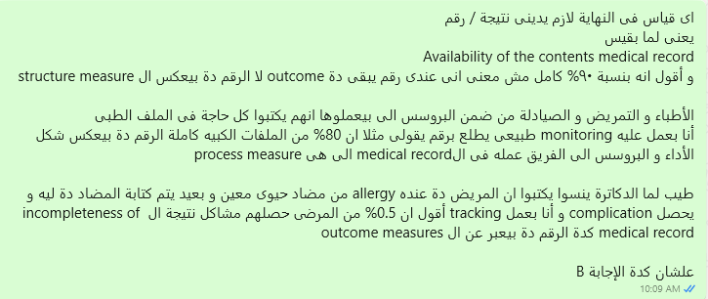
33-Completeness and accuracy of medical records are an example of a key hospital:
1. structure.
2. process.
3. outcome.
4. strategic goal

