Slide 1

Q1
Quarterly Performance Review (QPR)
Scorecards & Programs
April 26, 2023
COMPANY Business Services – Office of Strategy Management (OSM) 2023 ©
CONFIDENTIAL - FOR COMPANY INTERNAL USE ONLY

Slide 2
OFFICE OF STRATEGY MANAGEMENT (osm)
This report was developed Internaly by COMPANY OSM Team
CONFIDENTIAL - FOR COMPANY INTERNAL USE ONLY

Slide 3
Q1 2019 Quarterly Performance Review (QPR)
Meeting Agenda
1 | MD Introduction | 5 minutes
2 | COMPANY Holding Scorecard | 10 minutes
3 | Investments Scorecard & Program | 15 minutes
4 | Real Estate Scorecard & Program | 15 minutes
5 | Industrial Scorecard & Program | 10 minutes
6 | Hospitality Scorecard & Program | 10 minutes
7 | CFO Scorecard & Program | 10 minutes
8 | Business Support Scorecard & Program | 10 minutes
9 | MD Feedback & Conclusion | 5 minutes
CONFIDENTIAL - FOR COMPANY INTERNAL USE ONLY

Slide 4
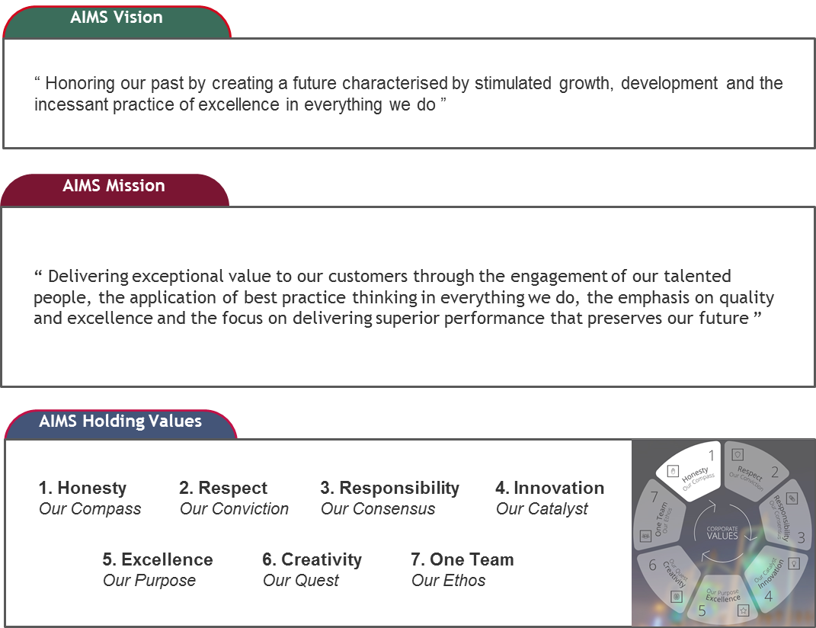
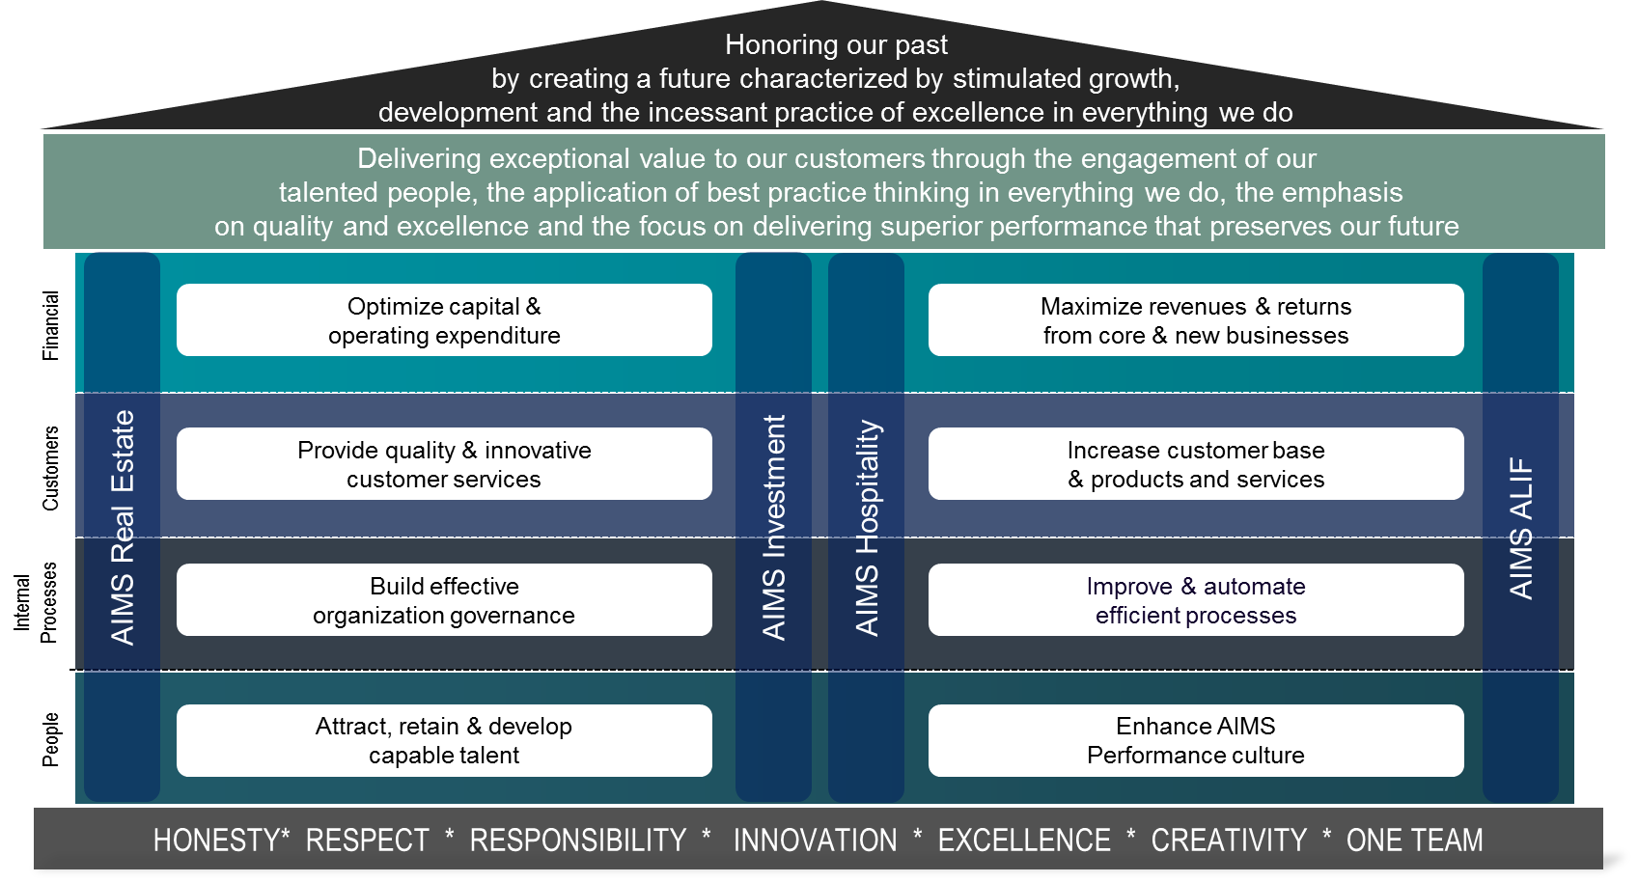
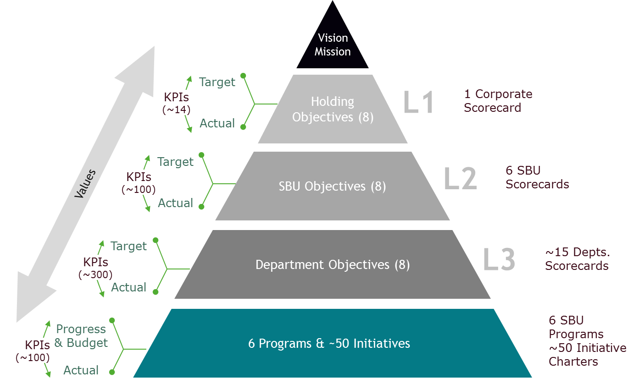
COMPANY Holding Vision, Mission, & Values
COMPANY Objectives & Strategy Map
COMPANY Strategy & Performance Framework
Before formulating a strategic plan, managers need to agree on their company’s aspiration for future results (vision), its purpose (mission), and the internal compass that will guide its actions (values).
Vision, mission and values should provide guidance to the board of directors, business partners, customers and employees regarding the organization’s direction. In the absence of this vital information, direction of the organization will be unclear and could contribute to a misuse of valuable resources (i.e. time and money) in pursuit of a strategy that is not aligned with the true course of the organization.
Translating holding strategic plan to operation requires clarity and specifics. Defining holding common objectives keeps the record of what COMPANY's leadership team has committed the corporation to achieving its vision and mission.
Generic holding objective definitions without related and clear holding KPIs could be damaging because they reduce the ability to implement the holding strategy due to build-in vagueness.
Holding common objectives are a powerful way to make COMPANY's holding strategy actionable. They provide the organization with specific holding targets, which when combined, support achievement of the organization’s vision and mission. The following is COMPANY strategy map:
COMPANY's Strategy & Performance Framework appears static. It should be noted that strategy and its execution is an iterative process and that performance KPIs and targets (at all levels) will drive behaviors, and that institutional leadership and support will dictate the level of success. In addition, this framework focuses primarily on describing the relationships between the key components necessary to manage strategic planning and performance effectively. Therefore, it is necessary to introduce a dynamic “Methodology” that will enable COMPANY to improve its strategy and performance management.

Slide 5
COMPANY
Executive Summary
1

Slide 6
COMPANY: Executive Summary
1
2
3
4
5
6
7
8
9
10
11
12
13
14

Slide 7
COMPANY: Executive Summary
Overall Performance Summary
All Scorecards Scores (%)
By Division
All Programs Progress (%)
By Program
All Due KPIs Status Summary
By Division
All Due Initiatives Status Summary
By Program
KPI Legend:
Prog. / Init. Legend:
>= 100%
80~99%
< 80%
Missing
Actual
Target
0% or Better
-1 to -20%
-21 or worse
Missing

Slide 8
COMPANY
Holding Scorecard
2

Slide 9
COMPANY: Overview & Scorecard Summary
Overview & Scorecard Summary
Key Achievements
Scorecard Score (%)
TOTAL
108%
Outstanding Items
Key Challenges & Risks
Planned Activities
Required Decisions & Support
Legend:
>= 100%
80~99%
< 80%

Slide 10
COMPANY: Financial & Customer KPIs
130%
Financial KPIs
107%
Customer KPIs
Legend:
Actual
Target
>= 100%
80~99%
< 80%
Not due
Missing

Slide 11
COMPANY: Internal Processes & People KPIs
54%
Internal Processes KPIs
129%
People . KPIs
Legend:
Actual
Target
>= 100%
80~99%
< 80%
Not due
Missing

Slide 12






Q1 Programs Performance
1
2
3
4
5
6
Investment
Program
Real Estate
Program
Industry
Program
Hospitality
Program
Business Services
Program
Finance & Accounting Program
Sponsor: Saleh
Sponsor: Aiman
Sponsor: Tandon
Sponsor: Amir
Sponsor: Tariq
Sponsor: Halim
Initiative (Manager Initials)
Initiative (Manager Initials)
Initiative (Manager Initials)
Initiative (Manager Initials)
Initiative (Manager Initials)
Initiative (Manager Initials)
Initiative (Manager Initials)
Initiative (Manager Initials)
Initiative (Manager Initials)
Initiative (Manager Initials)
Initiative (Manager Initials)
Initiative (Manager Initials)
Initiative (Manager Initials)
Initiative (Manager Initials)
Initiative (Manager Initials)
Initiative (Manager Initials)
Initiative (Manager Initials)
Initiative (Manager Initials)
Initiative (Manager Initials)
Initiative (Manager Initials)
Initiative (Manager Initials)
Initiative (Manager Initials)
Initiative (Manager Initials)
Initiative (Manager Initials)
Initiative (Manager Initials)
Initiative (Manager Initials)
Initiative (Manager Initials)
Initiative (Manager Initials)
Initiative (Manager Initials)
Initiative (Manager Initials)
Initiative (Manager Initials)
Initiative (Manager Initials)
Initiative (Manager Initials)
Initiative (Manager Initials)
Initiative (Manager Initials)
Initiative (Manager Initials)
Initiative (Manager Initials)
Initiative (Manager Initials)
Initiative (Manager Initials)
Initiative (Manager Initials)
Initiative (Manager Initials)
Initiative (Manager Initials)
Initiative (Manager Initials)
Initiative (Manager Initials)
SAMPLE
Black = Active in Q1 2019
Plan
Actual
Var.
Plan
Actual
Var.
Plan
Actual
Var.
Plan
Actual
Var.
Plan
Actual
Var.
Plan
Actual
Var.
6%
6%
0%
12%
13%
1%
7%
8%
1%
4%
4%
0%
4%
4%
0%
8%
11%
3%

Slide 13
SBU Name Here
Scorecard & Program
3

Slide 14
SBU Name Here: Overview & Scorecard Summary
Overview & Scorecard Summary
Key Achievements
Scorecard Score (%)
TOTAL
108%
Key Challenges & Risks
Outstanding Items
Key Challenges & Risks
Planned Activities
Required Decisions & Support
Legend:
>= 100%
80~99%
< 80%

Slide 15
SBU NAME HERE: Financial & Customer KPIs
130%
Financial KPIs
107%
Customer KPIs
Legend:
Actual
Target
>= 100%
80~99%
< 80%
Not due
Missing

Slide 16
SBU NAME HERE: Internal Processes & People KPIs
54%
Internal Processes KPIs
129%
People . KPIs
Legend:
Actual
Target
>= 100%
80~99%
< 80%
Not due
Missing

Slide 17
P1
Program Name Here
Program 1
Sponsor: Name here
INITIATIVES

Slide 18
Real Estate: Real Estate Program
Real Estate Program
1
Q1 Plan
6%
Q1 Actual
6%
Q1 Var.*
0%
Program Description
Key Risks & Challenges
Team
Sponsor:
SBU CEO
Initiatives Managers:
Strategic Objectives
Mitigation Plans
Budget (2019-2021)
Total: xx Mill SR
Spent: 0 SR
Initiatives
2019
2020
1 | 2 | 3 | 4 | 5 | 6 | 7 | 8 | 9 | 10 | 11 | 12 | Q1 | Q2 | Q3 | Q4 | 2021
Initiative
(End)
1
2
4
3
7
8
5
6
100%
Prog. Plan Dates
Start: 01-Jan-2019
End: : 31-Dec-2022
Legend:
Plan
Actual
Report Date
On Track
(0% Var. or Better)
Delay
(-1 to -20% Var.)
Off track
(-21% or worse)
* Rounded

Slide 19
Real Estate: Real Estate Program
1
Not due to report this quarter
Not due to report this quarter
Not due to report this quarter
Real Estate Program
Not due to report this quarter
Not due to report this quarter
Not due to report this quarter
Legend:
Actual
Target
0% or Better
-1 to -20%
-21 or worse

Slide 20
Initiative 1.1: Name of Initiative Here
1.1
Name of Initiative Here
Legend:
Actual
Target
0% or Better
-1 to -20%
-21 or worse

Slide 21
This page left blank

Slide 22
CEO Feedback & Conclusion
Feedback & Actions Summary
 | Item | Feedback | Action | Action By | Date
1
2
3
4
5
6
Plan Changes Summary
 | Original | Revised | Amendments | Item | Date
1
2
3
4

